Slide 1




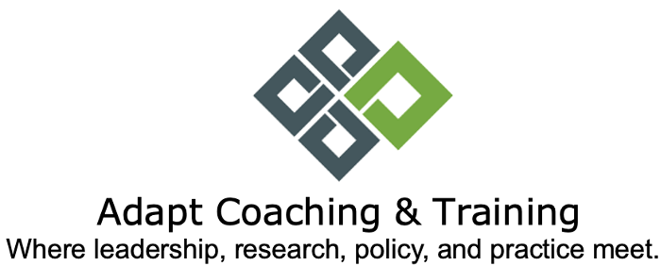
Empowering Neurodivergent Talent
Insights for Employers
Dr. TC Waisman

Slide 2

“Good design enables.
Bad design disables.”
Universal Design Conference, 2018 Dublin
Notes:
Start where you are…meaningful education is the best place to start and you can scale up as you grow your commitment

Slide 3

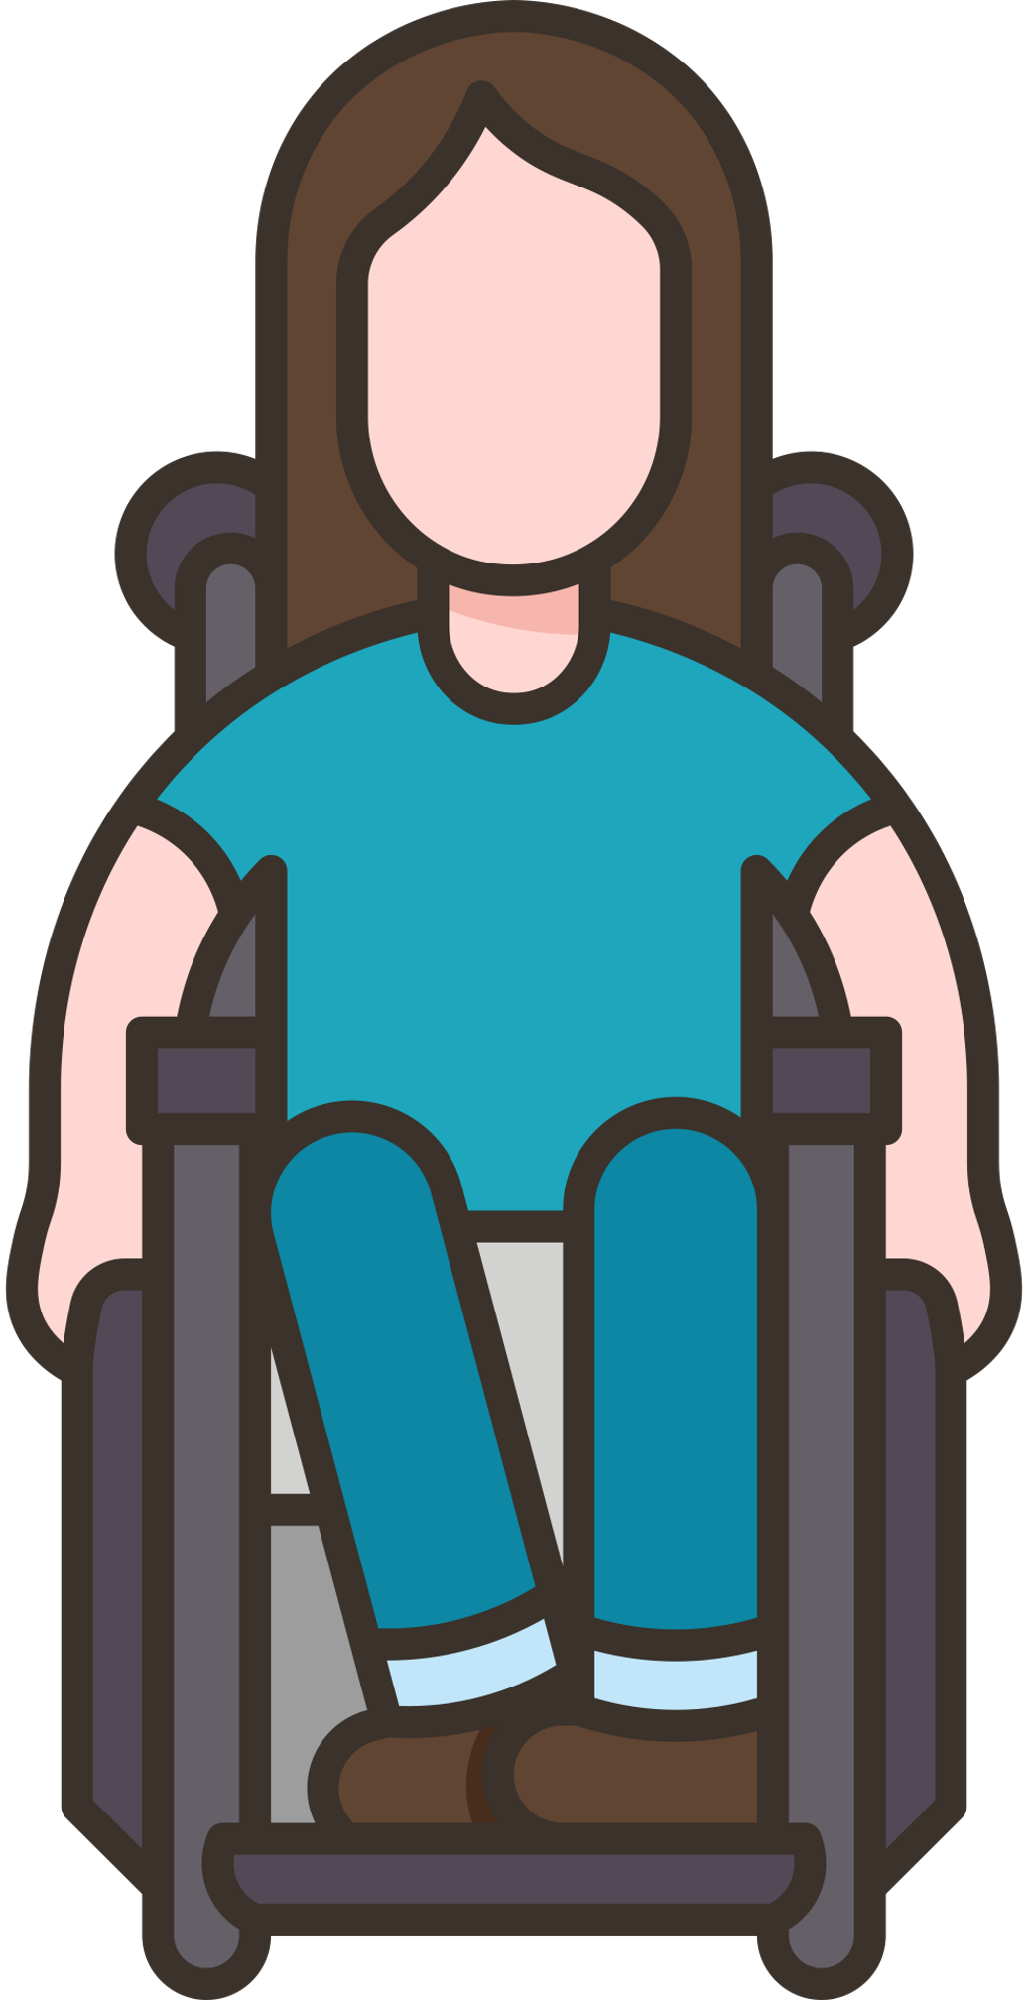




Terminology
Neurodiversity
Neurodivergence
Autism
Intersectionality
Ableism
Both a concept & social justice movement
The limitless variability of human brains & minds. All of us.
Acceptance & inclusion
Those whose neurology diverges from what is considered by society as ‘normal’
ADHD, autism, dyslexia, OCD, Schizophrenia etc.
Temp/perm changes due to cancer or injury
A complex lifelong neurological distinction characterized by social challenges, repetitive behaviours, & communication differences
The compounding & cumulative ways that multiple forms of discrimination combine, overlap & interact especially in the experiences of multiply marginalized people
Discrimination that favours & privileges able-bodied & neurotypically-minded individuals in society

Slide 4


Why Autism?
A rising tide lifts all boats

Slide 5
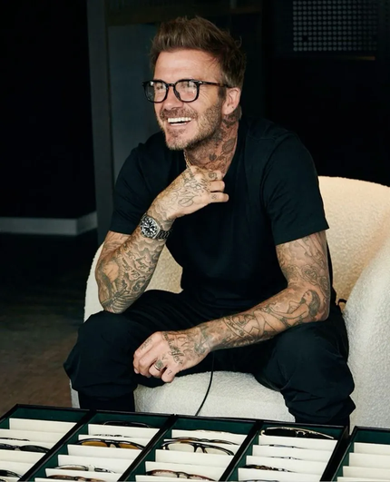
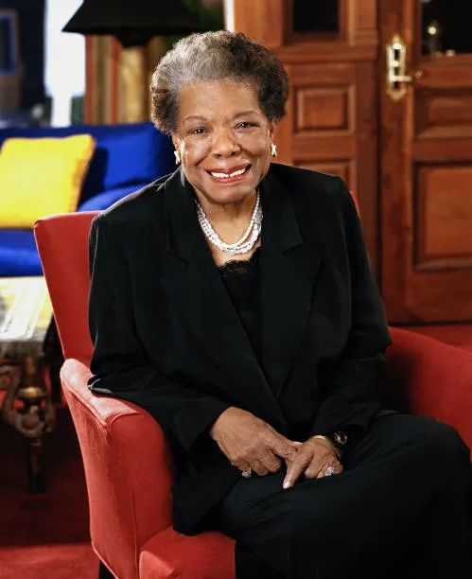
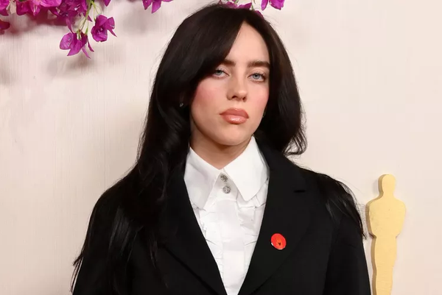
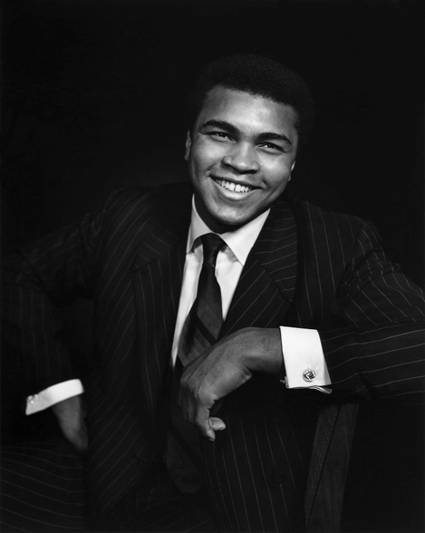

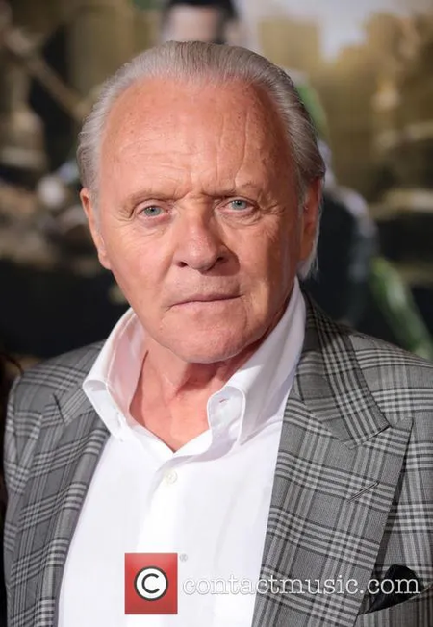
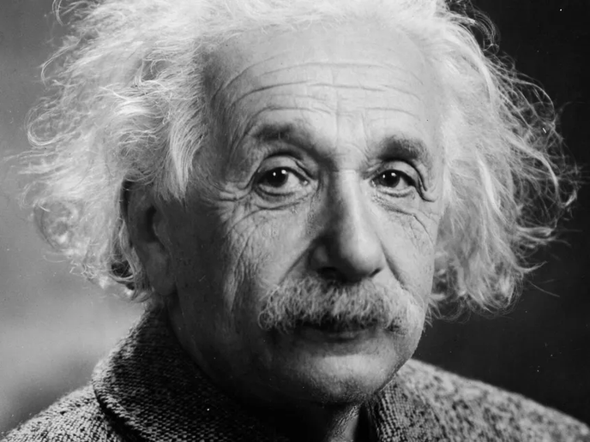

Neurodivergent people
David Beckham OCD
Maya Angelou Selective Mutism
Billie Eilish Tourette’s syndrome
Muhammed Ali Dyslexic
Anderson Cooper
Dyslexic
Daniel Radcliffe Dyspraxic
Albert Einstein Autistic
Sir Anthony Hopkins Autistic

Slide 6
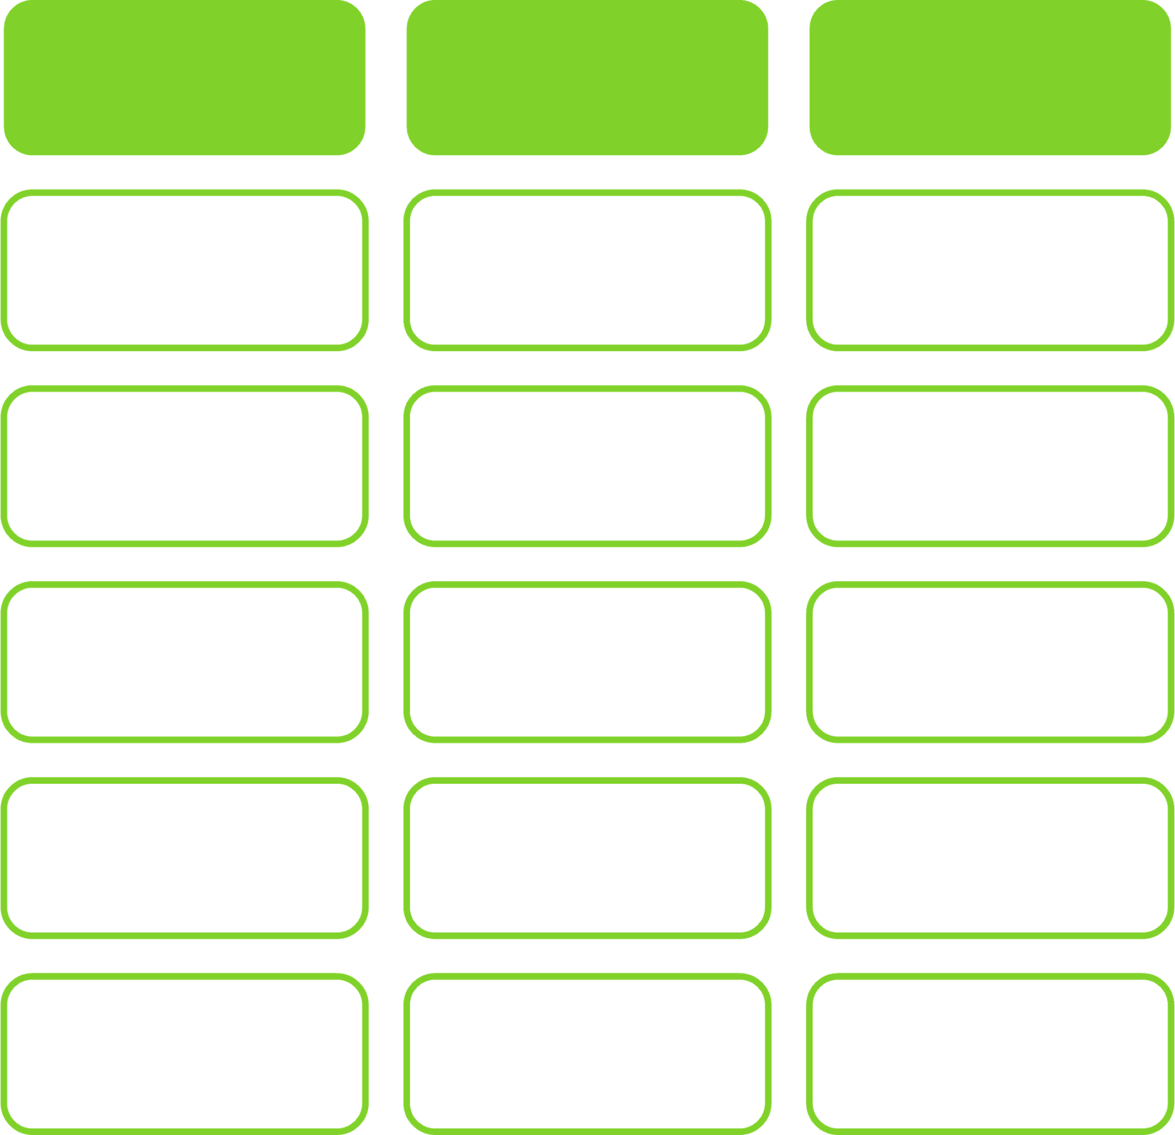
Medical
Lens
Neurodivergent
Lens
Internal & external
challenges
Individual is disabled
Change people:
make them normal
Change society
Improve person/
environment fit
Develop supports
often without
ND input
Nothing about us
Without us

Slide 7
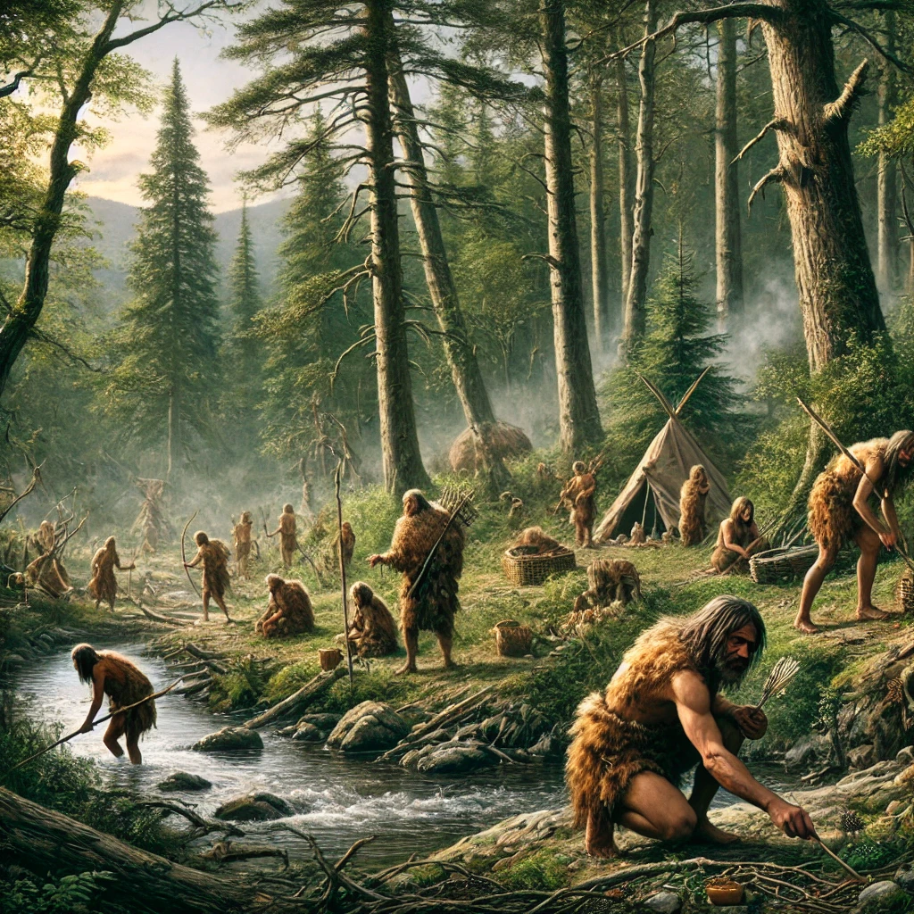
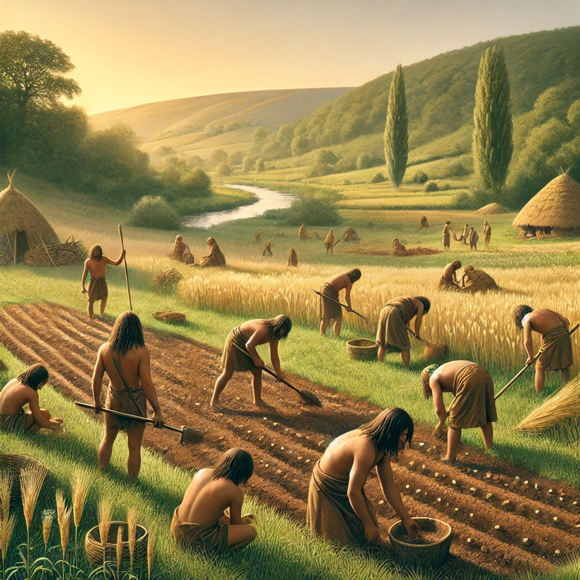
Neurodiversity Advantage
01
90% of human history = hunter gatherers
02
Leap = pattern seekers, planners, pioneers etc.
03
Complex civilization developed

Slide 8
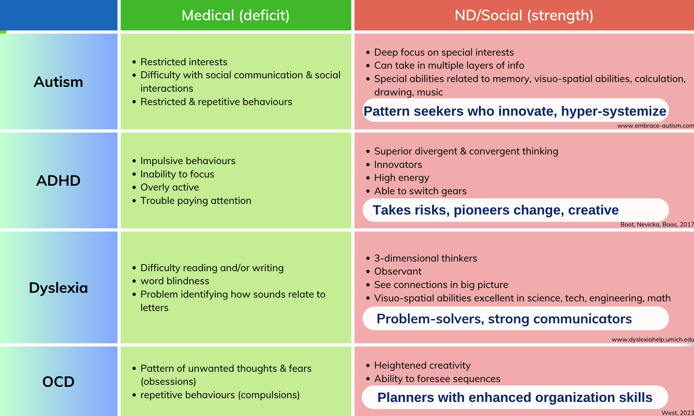
PERSPECTIVES IN THE WORKPLACE
Austin & Pisano 2017; Boot et al., 2017; White & Shaw 2006;

Slide 9
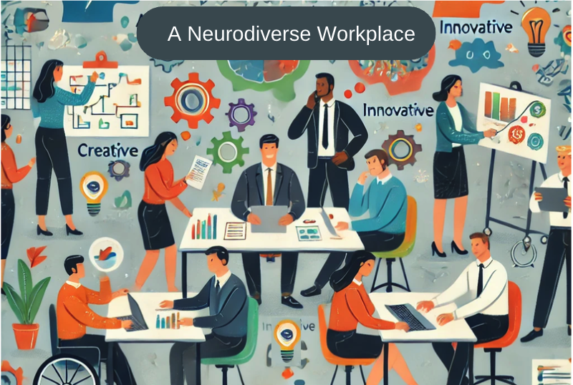
Organizational Benefits
Broader idea pool: enhanced innovation
Enhanced reputation & brand image
Social responsibility
Satisfaction & retention
Resilience
HBR, 2017

Slide 10
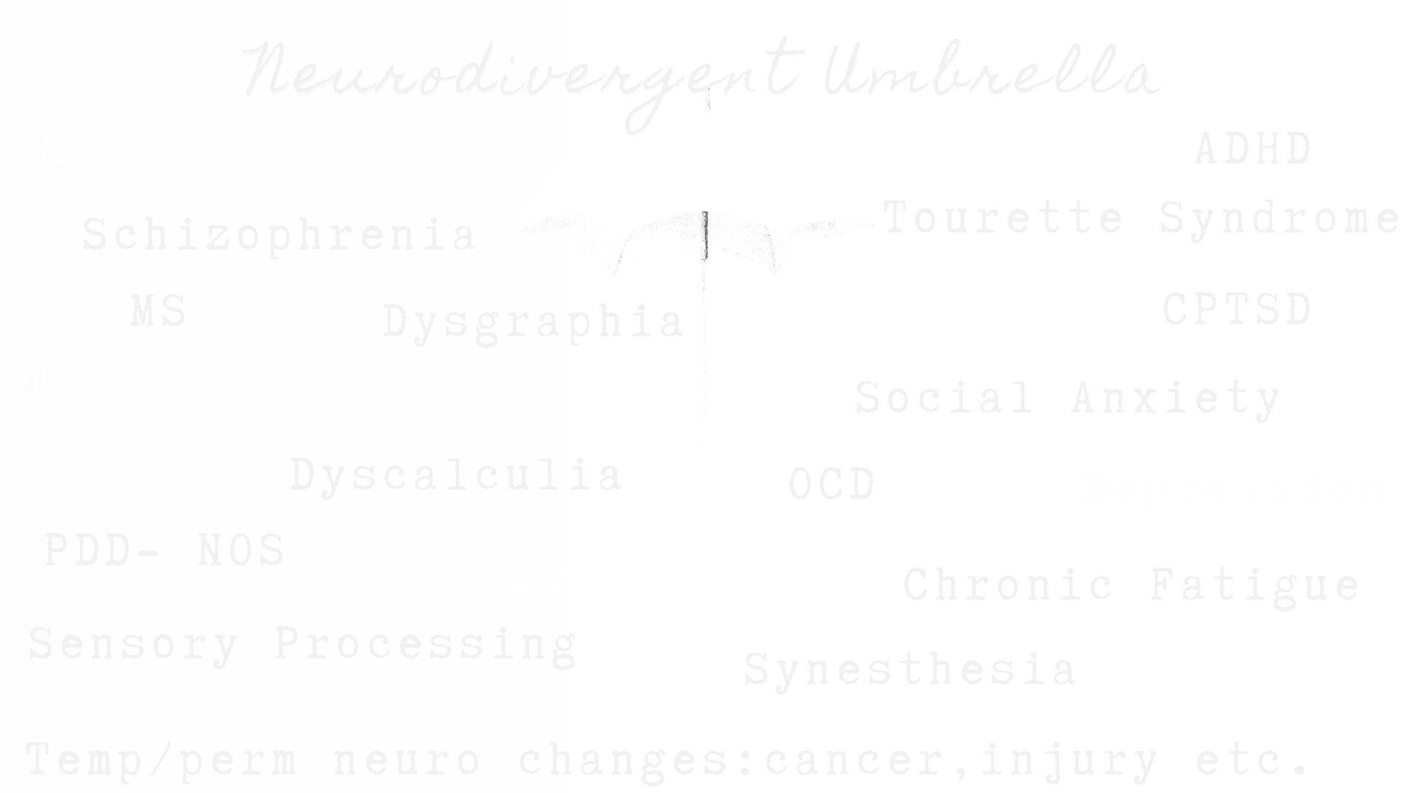
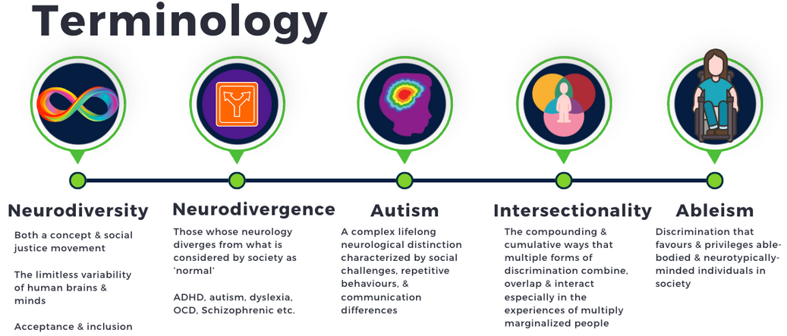
Do you consider yourself to be neurodivergent?

Slide 11
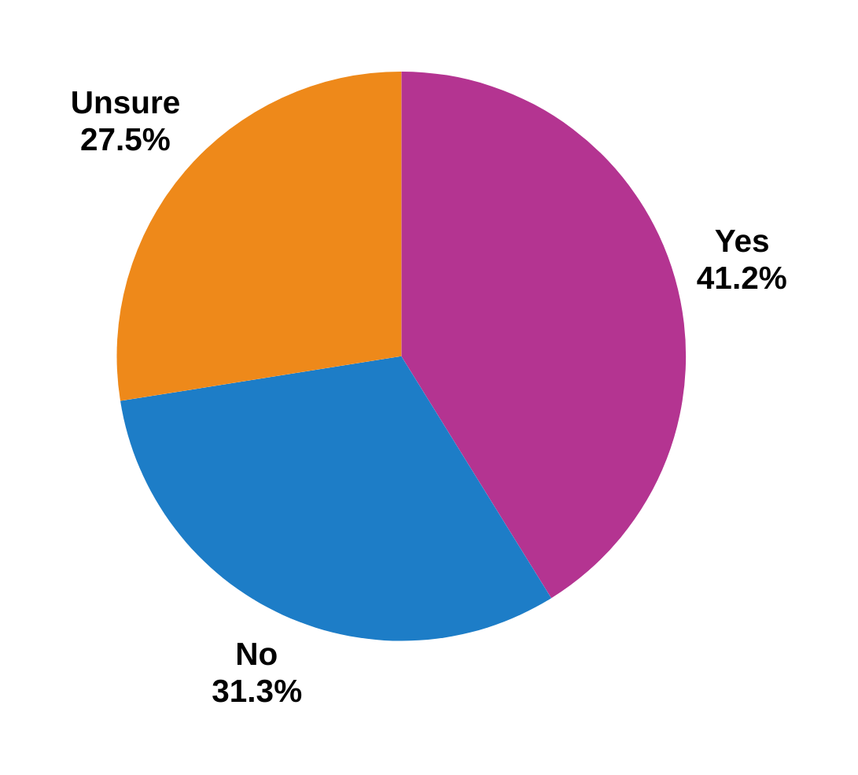

Do you consider yourself
NEURODIVERGENT ?
“Many of us chose ‘unsure’
because we just learned
about neurodivergence.”
Waisman, 2024

Slide 12

C-SUITE
45% of C-Suite Executives
55% of business owners
32% of Senior Managers
16–24-year-olds
38% self-identify as neurodivergent
Buccholz, 2024

Slide 13
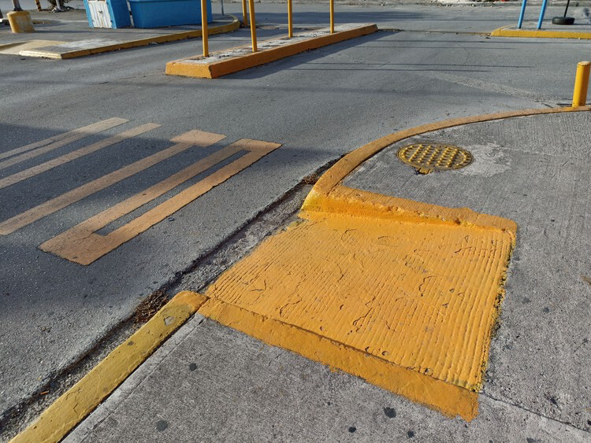

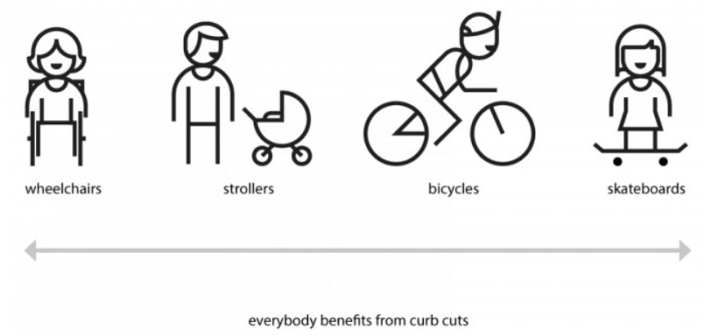
Accommodations
ARE
INNOVATIONS
Blackwell, 2017

Slide 14

Workplace Strategies

Slide 15


Dandelion Program
Pods of 8 Autistic employees deployed as a high-performance mini-ecosystem
30% more effective than other service teams
Retention rate = 96%
Autistic employees provide many benefits to the employer, teams, work environments, & the future of the organization
“No other initiative delivers benefits at so many levels” Nick Wilson HPE South Pacific
HBR, 2017; Jacob et al., 2015; My Assignment Help, 2022

Slide 16
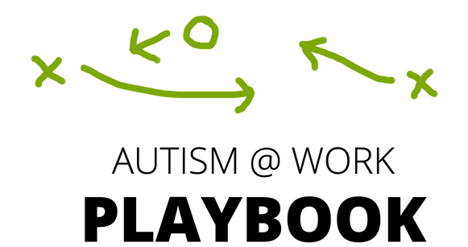
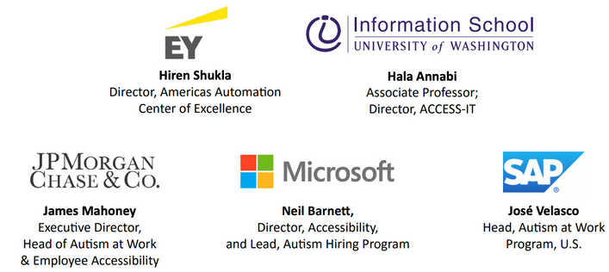
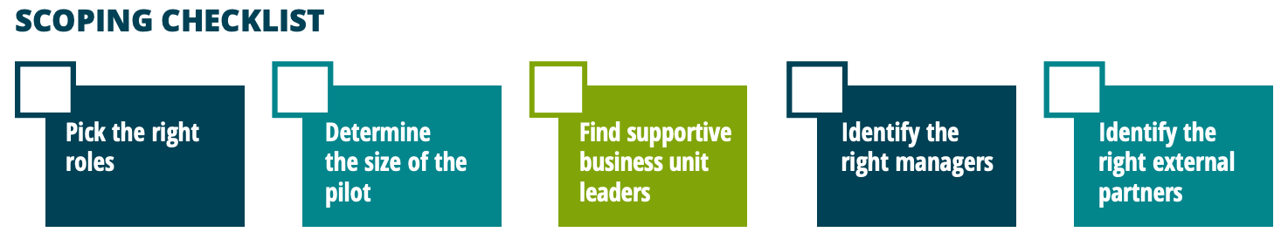
Notes:
Turnkey framework

Slide 17

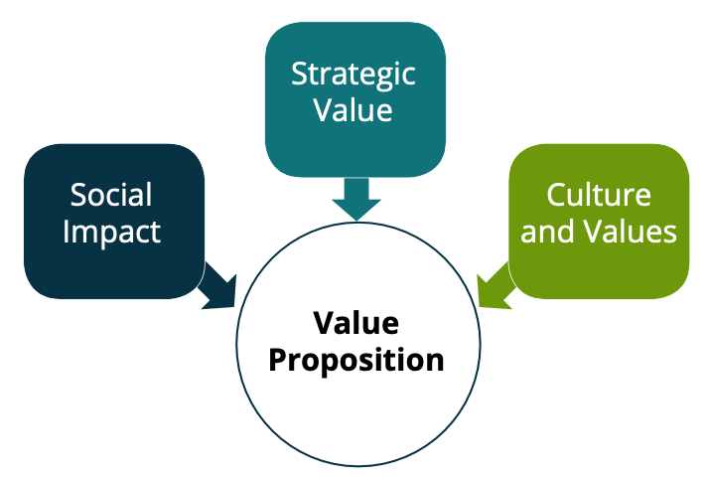
Chapters…
Developing a business case
Interview & selection processes
Training candidates, managers, and colleagues
Onboarding NDs into the workplace
Costs, ROI, & career development

Slide 18

How do we engage Universities?
Universities and colleges can be a great source of talent. Leading Autism @ Work firms formed fruitful relationships with universities to source talent in multiple ways. Research your local and regional universities. Identify universities and colleges that have autism-related programs to source talent and learn about the best ways to source and support those with autism.

Slide 19

What does success look like?
Creating meaningful employment opportunities for the autism and neurodivergent community
Finding talent
Building an organizational culture that is welcoming of differently-abled people more broadly
Providing value to the organization that is recognized by executives and the organization at large
Establishing sustainable programs that satisfy their organization’s needs
Influencing mainstream processes

Slide 20
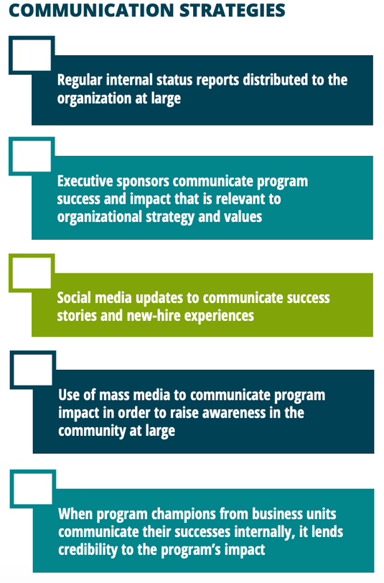
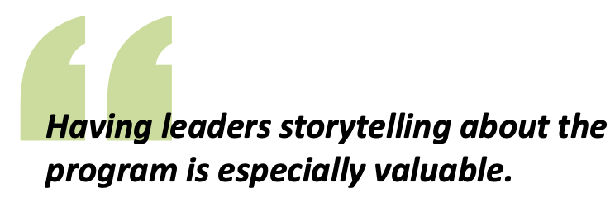
How do we communicate success?

Slide 21



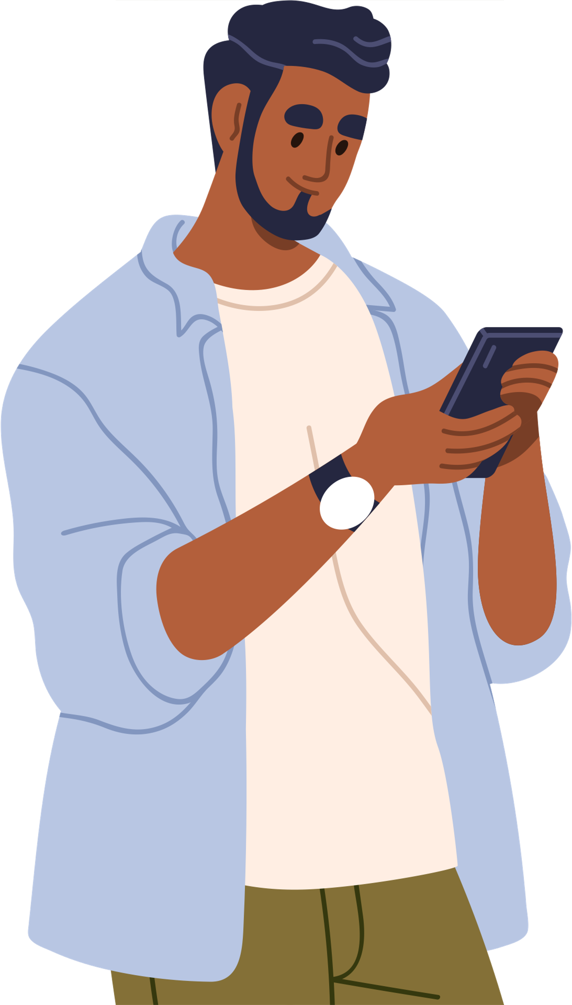

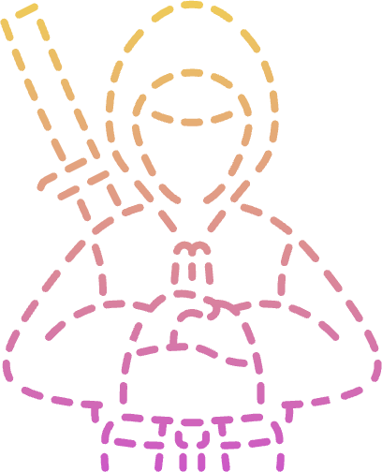
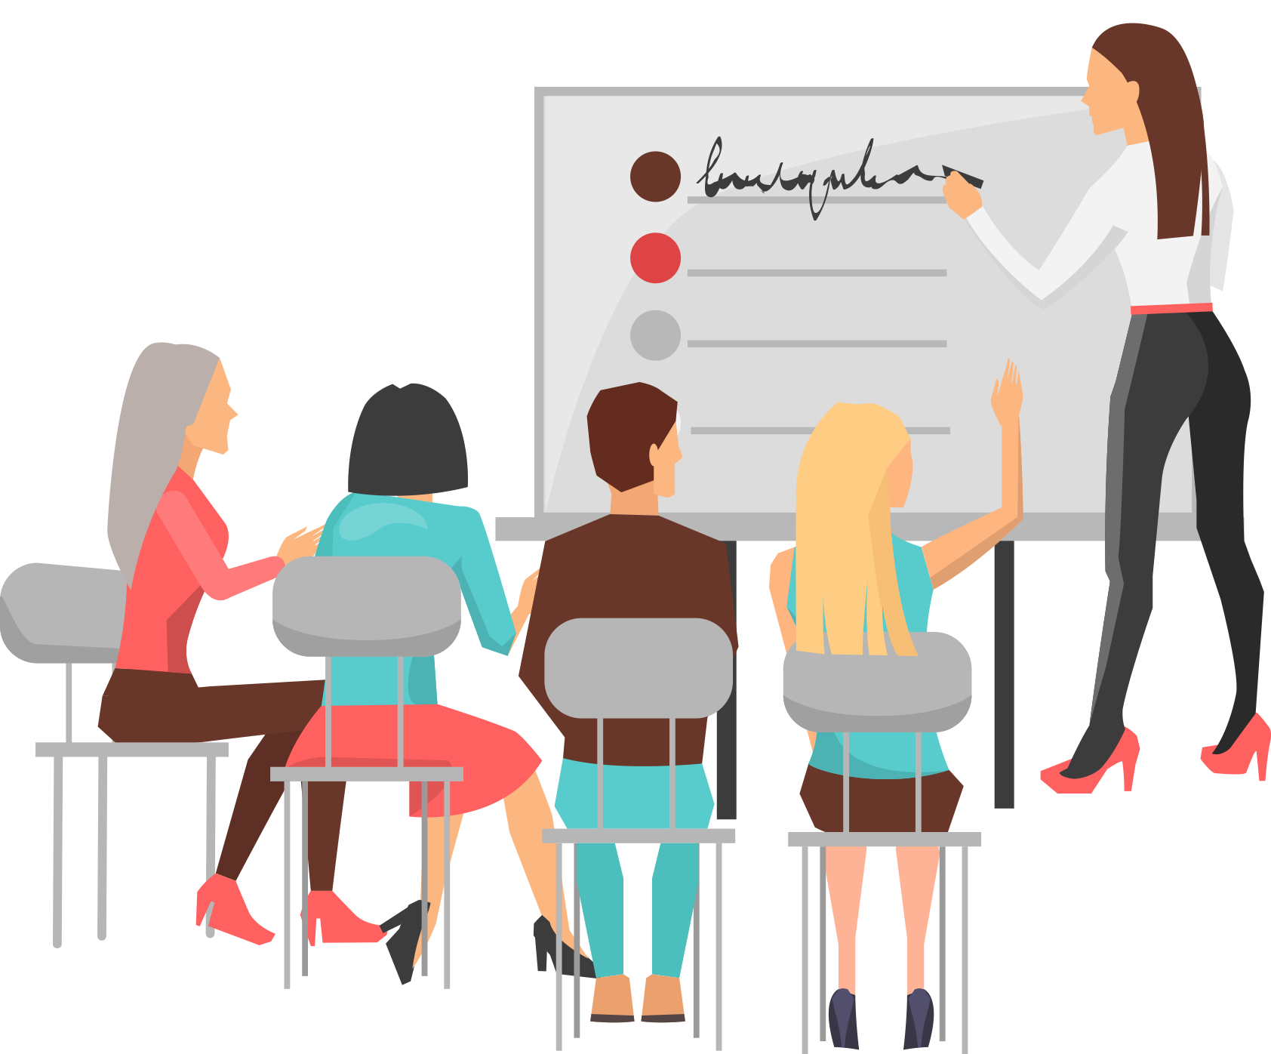

TC’s lived experience
Additions
Mentor & hubs
Remove the mystery
Invisble labour
Train & Measure
To answer questions, share culture, give day-to-day advice.
Develop or support hubs, affinity groups
Clarify any hidden curricula
Avoid depending on us to educate employees about how to work with NDs
Meaningful training for all employees created by NDs
Measure changes

Slide 22

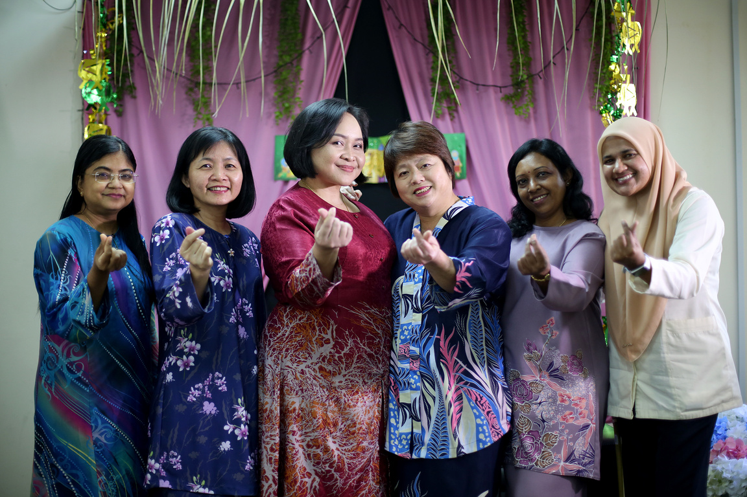


TC’s lived experience
Compounding challenges
Stereotypes & biases
Cultural differences
Microaggressions
Overlooked talent
  Hired to meet JEDI or disability criteria
  Considered unsuitable even if over/qualified
Seen as lazy, angry
  Religious adherences not considered (e.g. fasting)
  Cultural differences (e.g. no touching)
  Subtle or intentional discriminations (e.g. jokes or statements)
  Feel unsafe
  Unconscious bias by hiring panel
  We may not ‘look’ like typical leaders even if qualified

Slide 23
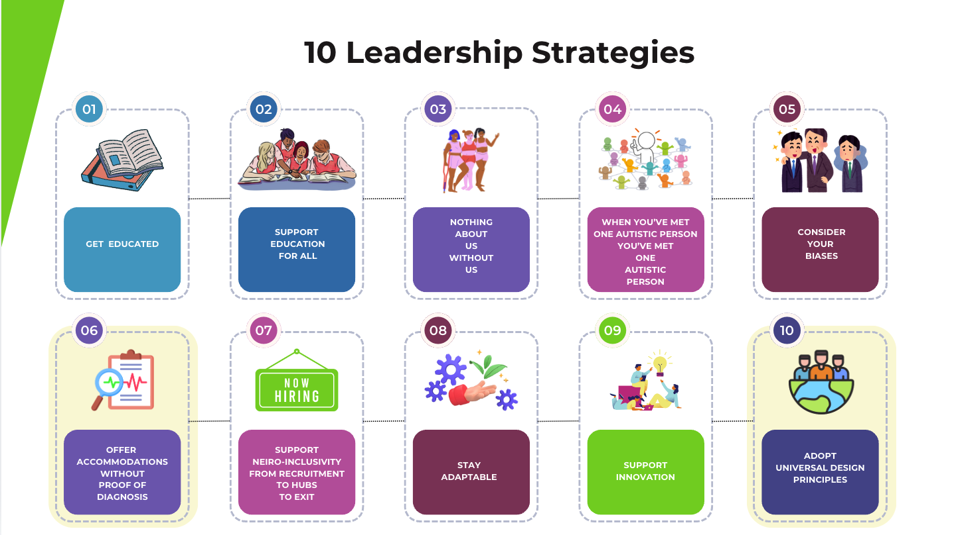

Slide 24
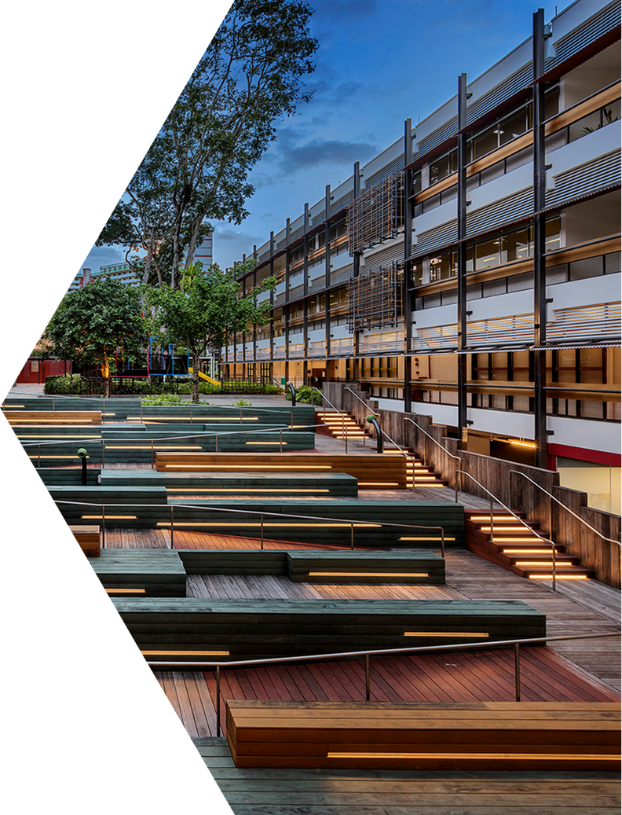
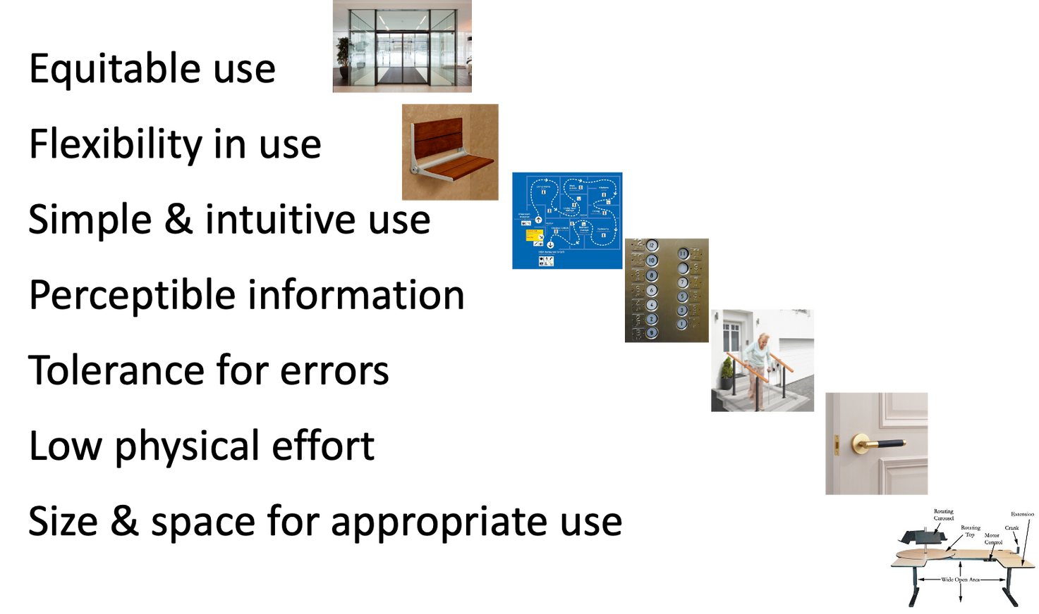
Universal Design
7 Principles
CEUD, 2024

Slide 25
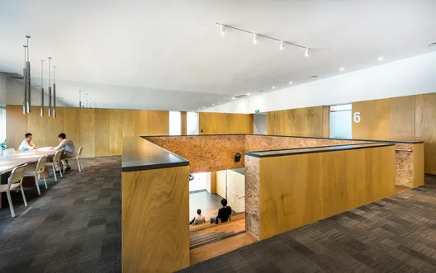
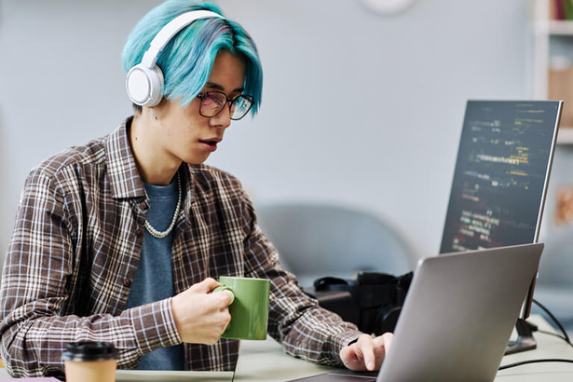
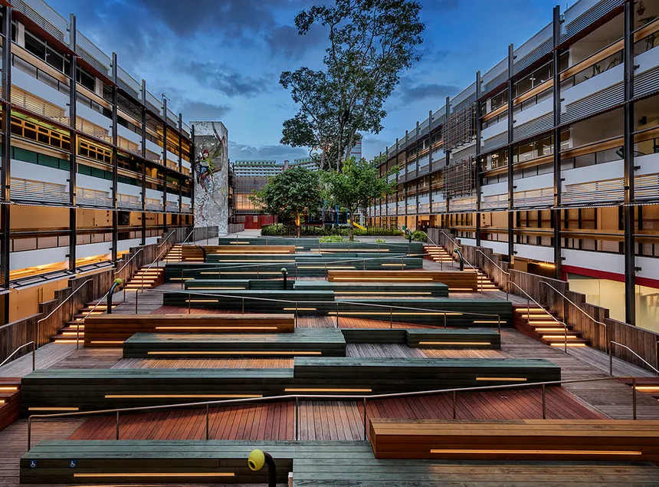
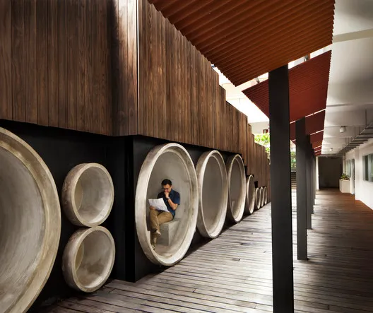
Enabling Village, Singapore
&
Enabling Masterplan 2030

Slide 26

